Slide 1
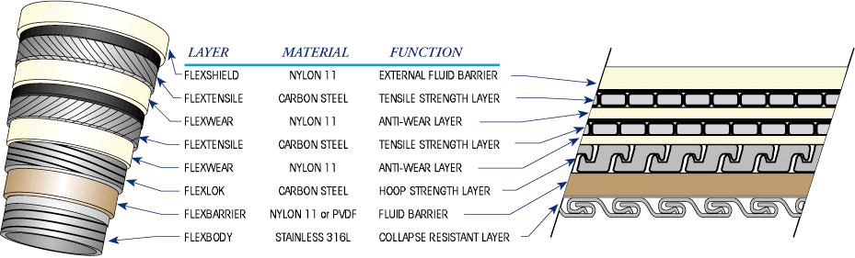
Peter Quiggin & David Heffernan
Orcina Ltd.
Based on OMAE2007-29315, joint work with Wellstream
Non-tensile layers bend with pipe and contribute non-hysteretic bend stiffness
Helical tensile layers experience stresses trying to slip them relative to adjacent layers
If these stresses overcome interlayer friction then wire slips, giving hysteretic contribution to bend stiffness
Ignoring slippage is inaccurate and unnecessarily conservative
Outer Sheath
Tensile Armour
Anti Wear layer
Tensile Armour
Anti Wear layer
Pressure Armour
Barrier
Carcass

Slide 2
Two computer models developed:
Orcina bending hysteresis model: applies non-linear moment-curvature data in a hysteretic way, for 2D or 3D bending.
Wellstream detailed pipe model: calculates individual tensile wire stresses and any slippage, and resulting bend moment contribution, for 2D or 3D bending.
OrcaFlex
Wellstream External Software Module
Orcina Bending Hysteresis Model
Wellstream Detailed
Pipe Model

Slide 3
Orcina Hysteresis Model
Takes as input a data table of moment as function of curvature in a single plane.
Applies this data in a hysteretic way.
Covers bending in 3D as well as in a single plane.
Does not calculate individual wire stresses, so cannot calculate fatigue damage to wires.
Uses a “first in, first out” rule for bending increments, which gives the classic hysteretic behaviour (as opposed to a “last in, first out” rule, which gives elastic behaviour).
Implemented as one of the options within OrcaFlex.

Slide 4
Wellstream Detailed Pipe Model
A detailed model that calculates the tensile wire slippage, stress and strain due to changes in curvature (magnitude and direction) and the resulting bend moment contribution.
Wire stress results enable fatigue damage to wires to be calculated.
Implemented in separate external software module.
At each time step it receives the curvature vector from OrcaFlex and calculates individual wire stresses and any slippage, and returns resulting bend moment vector.
OrcaFlex
At time step calculate pipe curvature vector C
(magnitude and direction)
C
Wellstream External Pipe Model
Update:
Tensile wire stress gradient and distribution
Pipe bending moments about two principle bending axes of pipe cross-section
Proceed to
next time step
OrcaFlex
Apply bending moment vector M and calculate resulting pipe motion in next time step
M

Slide 5
Full Scale Bending Test and Model Calibration
Full scale bending test was performed by SINTEF on a 4-inch pipe.
Curvature and moment measured at 7 bar, 100 bar and 200 bar internal pressure.
Test results used to calibrate the Wellstream bending hysteresis model.
Same loading conditions then simulated and models gave good match to test results.

Slide 6
Dynamic Response Case Study
Case study of 1628m catenary 4 inch riser, 200 bar internal pressure, pinned to FPSO in 1000m water depth. Regular and irregular waves simulated.
Simulations performed using Wellstream and Orcina models near touchdown zone. (Curvature elsewhere not sufficient for bending hysteresis to be significant.) Simulations also performed using linear bend stiffness, for comparison.
Time histories of curvature at touchdown show good agreement between Orcina and Wellstream models.
Considerable reduction in predicted curvature compared with the linear stiffness model.
This could have significant implications for subsequent fatigue analysis results.

Slide 7
Dynamic Response Case Study (continued)

Slide 8
Dynamic Response Case Study (continued)

Slide 9
Dynamic Response Case Study (continued)

Slide 10
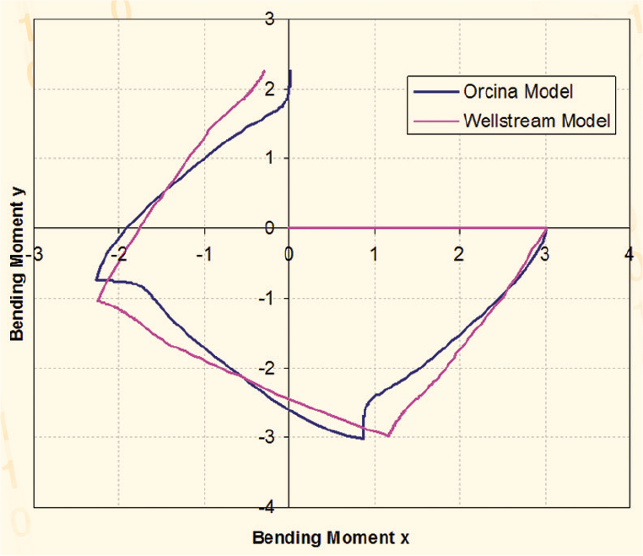
Comparison of Models for 3D Bending
For bending in 3D (changes in axis of curvature) the two models use completely different principles, but results match quite well.
This gives confidence in the way they handle bending in 3D, since the only commonality between them is the 2D moment-curvature data.

Slide 11
Time step requirements
Hysteresis is a highly non-linear effect and consequently shorter time steps are required.
For the cases considered here, 0.01s suffices, but as always sensitivity studies are recommended.

Slide 12
Conclusions
Effects of hysteresis important for accurate flexible pipe analysis
Modelling it allows conservatism to be removed
OrcaFlex hysteresis model is well validated
Data simple to input and readily available from flexible manufacturers
Models 3D bending accurately

